Slide 1
Project Presentation of CO-OP Project at Industry (Module-2) (22CS421)
On
Benchmarking the RAG Pipeline: An Empirical Evaluation of Chunking Strategies and Reranking across LLM Architectures
Team Members:
Abhinav Sharma (2210991155), Lakshay Kumar (2210990536)
Sneha Sharma (2210990859), Paras Kapoor (2210990637)
Supervised By
Dr. Swati Goel
Department of Computer Science and Engineering, Chitkara University, Punjab

Slide 2

Introduction
Retrieval-Augmented Generation (RAG) dynamic generation ensures Large Language Models (LLMs) use current, correct data, reducing hallucinations.
However, RAG performance is highly susceptible to design decisions (chunk sizes, retrieval depth) often based on heuristics, not systematic evidence.
Suboptimal configurations lead to poor answer quality and unnecessary computational overhead.
2

Slide 3

Problem Statement
There is a lack of systematic studies justifying RAG configuration choices.
The effects of retrieval noise, context truncation, and prompt strategies are underexplored.
Practitioners struggle to balance factual accuracy and computational efficiency without controlled analysis.

Slide 4



Objective
Conduct a controlled experiment using 36 core configurations (chunking, retrieval depth, reranking, and prompt strategy).
Test 324 extended configurations to analyze interactions between noise injection and context windows.
Provide evidence-based recommendations to maximize token-level F1 scores and minimize hallucinations

Slide 5
Experimental Setup
Chunk Sizes: 128 vs. 256 tokens (with 32-token overlap).
Retrieval Depth (top-k): 3, 5, and 10.
Reranking: Cosine similarity only vs. Cross-encoder reranking.
Prompt Strategies: Baseline, Strict, and Citation.
Noise Levels: 0%, 30%, and 60% random corpus chunk injection.
Max Context Window: 2, 3, or 5 chunks passed to the LLM.

Slide 6
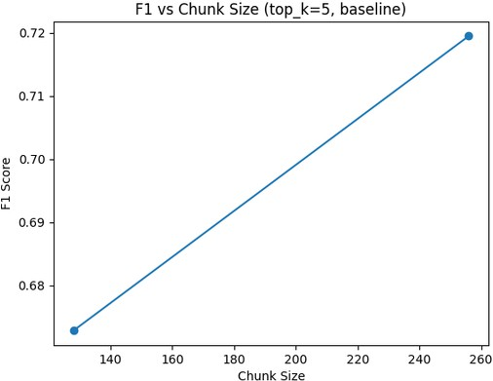
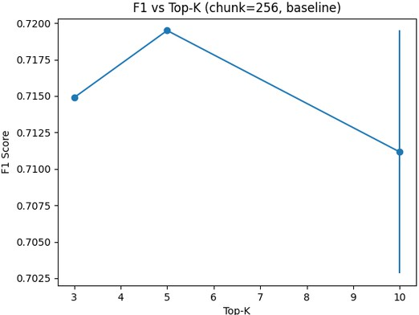
Core Results: Chunk and Top-k
Larger Chunks Win: 256-token chunks consistently provided a 4.7% to 6.9% F1 boost over 128-token segments.
Semantic Coherence: Larger chunks prevent the fragmentation of answers across boundaries.
Optimal Retrieval (top-k): Setting k=3 to 5 is the Pareto-optimal depth.
Diminishing Returns: Increasing k to 10 showed negligible F1 gains and slightly decreased performance when reranking was enabled.

Slide 7
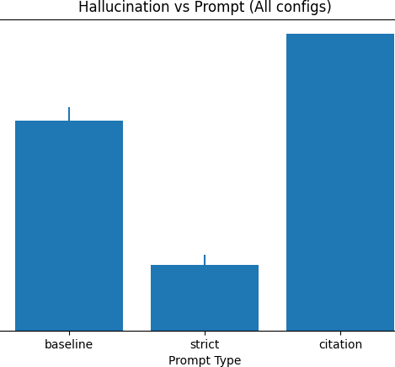
Prompt and Reranking Effects
Baseline Prompt: Maximized token-level F1 at 0.72.
Strict Prompt: Reduced F1 slightly (-6.4%) but significantly lowered hallucination rates.
Citation Prompt Collapse: Caused a 73.5% F1 drop due to metric incompatibility (extra citation tokens penalized the score).
Reranking Reality: Cross-encoder reranking offered zero to negligible benefits at low retrieval depths (k=3 to 5) for extractive tasks.

Slide 8
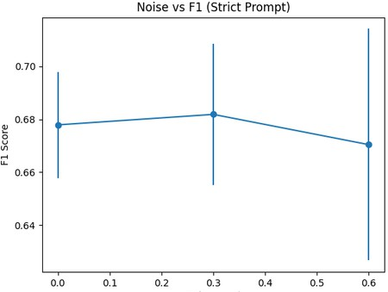
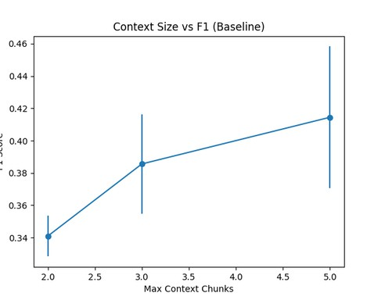
Noise and Context Effects
The Discovery: Strict prompting combined with moderate noise (30% to 60%) unexpectedly raised the F1 score to 0.75 (the study maximum).
The Mechanism: Irrelevant chunks force the strict-prompted model to produce much shorter, highly extractive answers.
Average Answer Length: Dropped from approximately 30 tokens to 2.7 tokens under these conditions.
Takeaway: Noise acts as an implicit regularizer when paired with strict instructions.
8

Slide 9
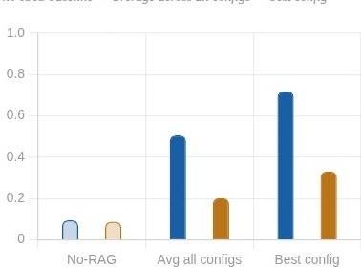
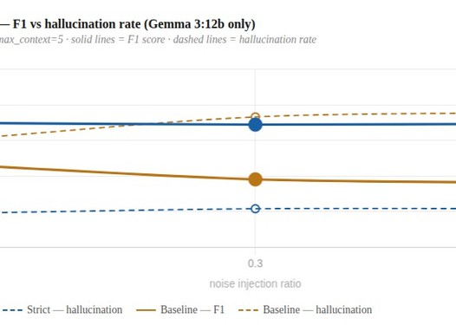
Gemma vs LLaMA Pilot Comparison
Performance Comparison: Gemma 3:12b peaked at an F1 of 0.72.
Pilot Performance: LLaMA 3.2:3b peaked at an F1 of only 0.35.
Instruction Fidelity: The smaller 3B model struggled significantly with strict and citation prompts.
Conclusion: Compact 3B models may be insufficient for high-quality extractive RAG; scale remains a critical factor.

Slide 10
Practical Recommendations
Chunk Strategy: Use 256 tokens with a 32-token overlap. Retrieval: Cap retrieval depth at k=3 or 5.
Efficiency: Disable cross-encoder reranking unless the candidate pool is exceptionally large and diverse.
Prompting: Use Baseline prompts for maximum F1, or Strict prompts if hallucination control is your primary constraint.
Model Selection: Budget for 12B parameter models over 3B models for reliable extraction.

Slide 11
Conclusion and Future Scope
Limitations: Token-level F1 penalizes grammatically natural answers; SQuAD is purely extractive; SQuAD subset limits statistical power.
Future Evaluations: Scaling to full SQuAD dataset and multi-domain benchmarks (TriviaQA, HotpotQA).
Future Metrics: Incorporating semantic similarity metrics (BERTScore) and LLM-as-a-judge evaluations.
Future Architectures: Exploring semantic chunking and adaptive retrieval policies.

Slide 12
Thank You

